Slide 1
Design pattern: Observer
Notes:
Objectives:
Understand the observer design pattern.
Understand the push and pull variants of the pattern.
Relate to the dependency inversion principle.
Understand C# delegates and events.

Slide 2
The general “data-update” problem
Provider contains data which changes every now and them
Consumer uses data and would like to do some update based on changes in data
How can we realize this coupling?

Slide 3
Discuss pros and cons of these typical solutions:
Provider notifies Consumer when data changes
Consumer polls Provider
Notes:
There is very high coupling between producer and consumer.

Slide 4
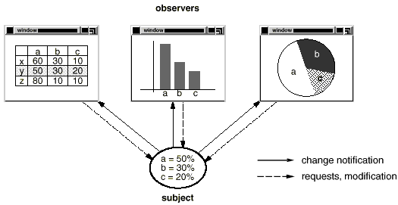
Simple example
Notes:
Typically, the provider holds data, which is interesting for multiple consumers.
TODO: Find a better looking example.

Slide 5

GoF Observer
We need some mechanism that…
allows Consumers to be added to the Provider without changing the Provider (i.e. adhere to OCP)
allows Provider to inform Consumers of data changes (i.e. promotes low coupling)
allows many Consumers to be informed on updates of same data
We need….GoF Observer!
Define a one-to-many dependency between objects so that when one object changes state, all its dependents are notified and updated automatically

Slide 6
Observer class diagram
Subject is an abstract base class for all data subjects
(i.e. things that get updated)
Observer is an interface that must be implemented by all classes that wish to be informed of data changes
ConcreteSubject inherits from Subject. This is the actual class that must be monitored (in our case, Provider)
ConcreteObserver implements the Observer interface. This is the actual class that must receive updates (in our case, Po)
Notes:
What is the responsibility of the abstract Subject class?

Slide 7
Naming
Subject, provider, observable
Just different names for the same thing.
Consumer, observer
Also just different names for the same thing.

Slide 8
Notifications, sequence diagram
Notes:
Note that the concrete observer knows the concrete subject, in order to subscribe to it.
The subject does not know the type of the class subscribing to it, only that they implement the Observer interface.

Slide 9
Many observers to one observable
Let the subject hold a list of observers.
Then many observers can attach to the same subject.
An observer can remove it self from the list, by calling Detach.
Notes:
TODO: Shall we include the variant, where the same observer can be notified by many different observables?

Slide 10
Push variant

Slide 11
Push vs. pull
Pull variant (Observer pulls state from subject)
Push variant (Subject pushes state to observer)

Slide 12
GoF Observer – handling subjects of different types
How can we handle observers that connect to subjects of different types?
Use C# generics to specify the type of subject(s) to observe
Implement Update for each SubjectType

Slide 13
C# Speficics: delegates and events

Slide 14
Dependency Inversion Principle

Slide 15
Summary

Slide 16
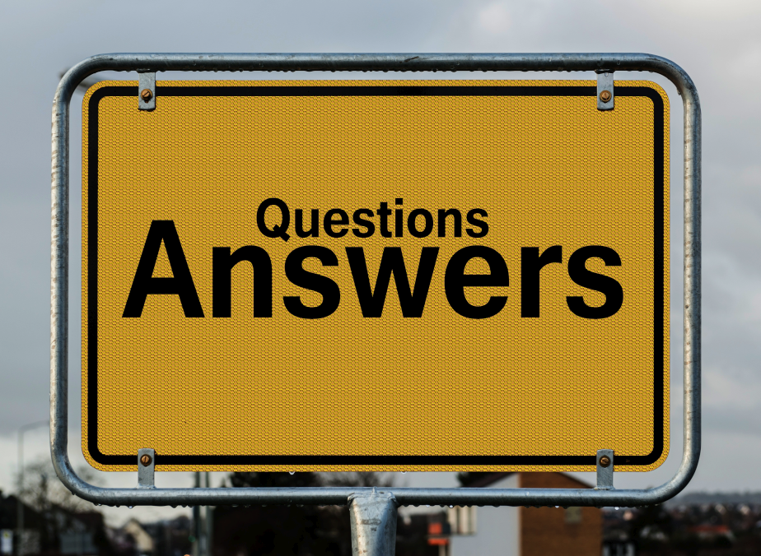

Slide 17
References
Questions-Answers: https://www.pexels.com/photo/questions-answers-signage-208494/

Slide 18
Notes:
18

